Slide 1
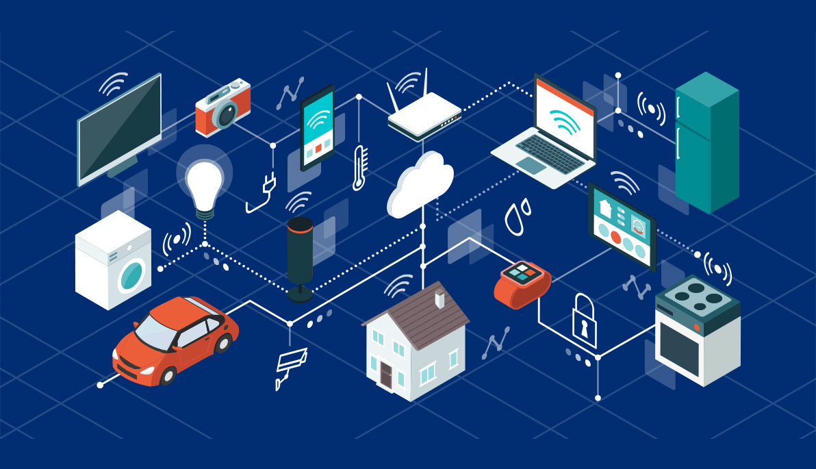
Mobile Edge Computing
Transforming
Telecommunications
Infrastructure
Sohaib Ahmed ( 21L-5635 )
M Hassan Khalid ( 21L-5692 )
M Hamza ( 21L-5636 )
Instructor Danyal Farhat

Slide 2
Table of contents
01
02
03
05
06
07
04
Abstract
Introduction
Literature
Review
Research Methodology
08
Implementation
References
Potential Research Gaps
Conclusion &
Future Directions

Slide 3
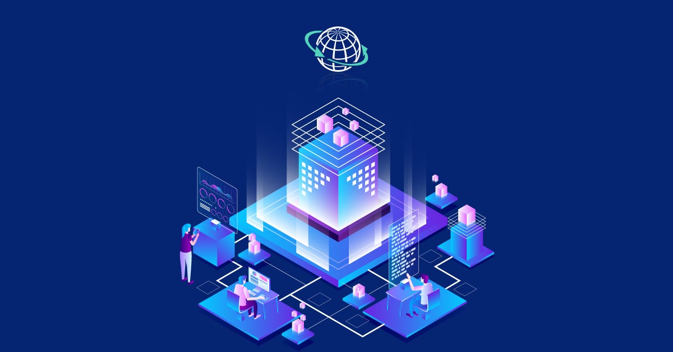
01
Abstract

Slide 4

Exploring the Frontier of Mobile Edge Computing
Mobile Edge Computing (MEC) enhances user experiences by significantly reducing latency and optimizing the processing of data near its source, which results in faster response times and improved efficiency.
The study explores the structural distinctions of MEC compared to traditional cloud computing, highlights the roles of NFV and SDN in enhancing scalability and flexibility, and discusses the integral challenges of security and privacy within MEC systems.

Slide 5
02
Introduction

Slide 6
Mobile Edge Computing at the Edge of Innovation
MEC is a transformative paradigm in telecommunications, enabling low-latency, high-bandwidth applications.
Despite its promise, MEC faces challenges in architecture, energy efficiency, security, and integration with existing technologies.

Slide 7
03
Literature Review

Slide 8
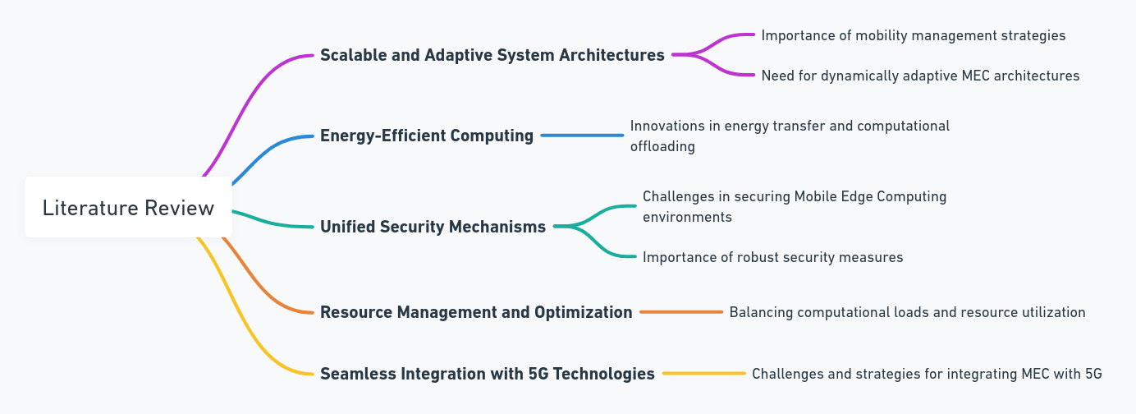
Literature Review
Mobile Edge Computing

Slide 9
04
Research Methodology

Slide 10
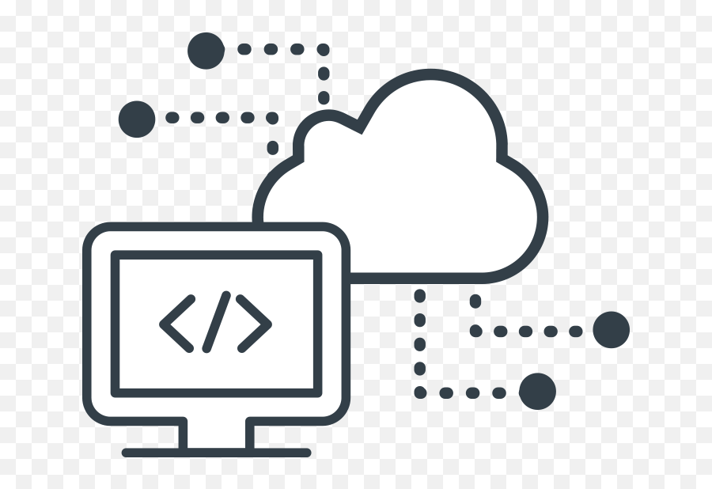
Edge Cloud Architecture
Offloading Algorithm
Hierarchical Federated Learning (HFL)
Three-tier structure for efficient task handling and resource distribution. IoT Device Tier, Edge Server Tier, and Cloud Layer.
Delay-Aware Energy-Efficient (DAEE) algorithm for energy-efficient offloading.
Improving security through local computation and cluster aggregation.

Slide 11
05
Potential Research Gaps

Slide 12
Real-World Testing
Cross-Domain Applications
Despite theoretical advancements in Mobile Edge Computing (MEC), there is a notable gap in the real-world testing and validation of these proposed solutions.
The paper might lack extensive coverage on the application of MEC across diverse industries such as healthcare, agriculture, and smart cities, suggesting a gap in cross-domain applicability.
User-Centric Design
Economic Impact
There is a potential oversight in integrating user-centric design principles within the development of MEC applications, focusing predominantly on technological and infrastructural aspects.
The paper does not thoroughly explore the economic implications and potential business models that MEC enables, representing another significant research gap.

Slide 13
06
Implementation

Slide 14
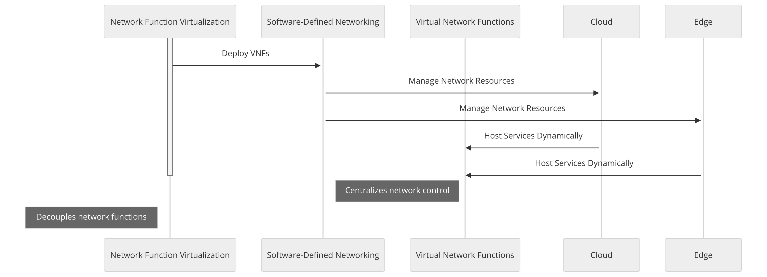

Slide 15
NFV and SDN Integration:
Integrates Network Function Virtualization (NFV) and Software-Defined Networking (SDN) to manage MEC resources effectively. NFV turns network functions into software applications, while SDN centralizes control for real-time resource and traffic management.
Dynamic Resource Allocation:
NFV and SDN facilitate the dynamic allocation of resources, adjusting quickly to demand fluctuations to maintain optimal performance and enhance user satisfaction.
Reduced Latency and Energy Efficiency:
Optimizing network routing and service placement at the edge reduces latency and conserves energy by minimizing dependence on physical hardware.
Operational Cost Reduction:
Streamlining resource management and reducing specialized hardware needs cuts operational costs significantly in deploying and managing network services.

Slide 16
07
Conclusion & Future Directions

Slide 17
MEC is transforming telecommunications by enabling low-latency, high-bandwidth capabilities.
Dynamic orchestration and integration with existing infrastructure.
Innovative approaches for energy consumption and resource allocation.
Robust security mechanisms.
Application of AI and ML for network management and predictive resource allocation.
Ensuring interoperability and collaboration across heterogeneous platforms.

Slide 18
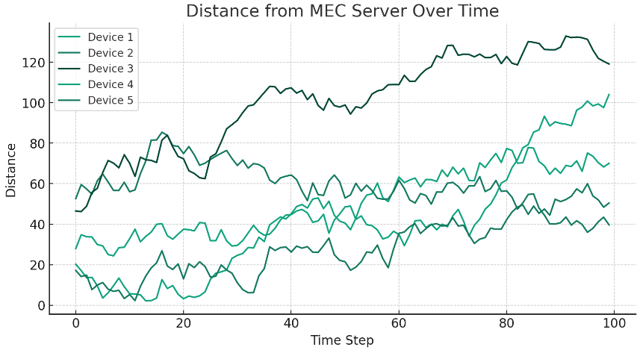
Results Obtained
Results from an experiment analyzing distances between mobile devices and a MEC server.
Observations on signal strength, device performance, and computational efficiency.
Importance of considering mobility and signal strength for efficient resource allocation and reduced latency.

Slide 19

Breaking Barriers: Japan Unveils 6G Prototype Device with Astonishing Speeds
Announced on April 11th, the prototype device stunned the world with its ability to transmit data at a staggering 100 gigabits per second (Gbps), surpassing the current 5G technology by a remarkable 20-fold margin. Operating in the 100 gigahertz (GHz) band indoors and the 300 GHz band outdoors, this feat marks a significant milestone in the evolution of wireless communication.
Author : Leo Rigasaki
May 3rd,

Slide 20
08
References

Slide 21
Y. Mao, C. You, J. Zhang, K. Huang, and K. B. Letaief, "A Survey on Mobile Edge Computing: The Communication Perspective.“ X. Chen, L. Jiao, W. Li, and X. Fu, "Efficient Multi-User Computation Offloading for Mobile-Edge CloudComputing.“ Y. Zhang, "Mobile Edge Computing for Beyond 5G/6G.“ Xiaojie Wang, Jiameng Li, Zhaolong Ning, Qingyang Song, Lei Guo, Song Guo, and Mohammad S. Obaidat, "Wireless Powered Mobile Edge Computing Networks: A Survey." N. Abbas, Y. Zhang, A. Taherkordi, and T. Skeie, "Mobile Edge Computing: A Survey." Mohammed Abd-Elnaby, Germien G. Sedhom, El-Sayed M. El-Rabaie, and Mohamed Elwekeil, "NOMA for 5G and beyond: Literature Review and Novel Trends." A. Kaliwo, C. Nyirenda, "Enhancing Digital Health in 6G Networks: A Cybertwin-driven Fuzzy Approach to Medical Traffic Identification and Classification." MABS Abir, MZ Chowdhury, "Digital Twin-based Aerial Mobile Edge Computing System for Next Generation 6G Networks."

Slide 22
W. Yu, TJ Chua, J. Zhao, "Orchestration of Emulator Assisted Mobile Edge Tuning for AI Foundation Models: A Multi-Agent Deep Reinforcement Learning Approach." S. Roy, S. Kalafatis, "RoboCon: A Modular Robotic Containerization, Orchestration, and Load Balancing Technique for Mixed Hierarchy Task Handling Across Computing Platforms.“ Miranda McClellan, Cristina Cervelló-Pastor, and Sebastià Sallent, "Deep Learning at the Mobile Edge: Opportunities for 5G Networks.“ Yue Wang, Zhi Tian, Xin Fan, Yan Huo, Cameron Nowzari, Kai Zeng, "Distributed Swarm Learning for Internet of Things at the Edge: Where Artificial Intelligence Meets Biological Intelligence.“ Pritchard, Craig & Beheshti, Yousef & Sepahi, Mohammad, "Mobile Edge Computing: Architecture, Use-cases, Applications.“ Xiucheng Wang, Nan Cheng, Lianhao Fu, Wei Quan, Ruijin Sun, Yilong Hui, Tom Luan, Xuemin Shen, "Scalable Resource Management for Dynamic MEC: An Unsupervised Link-Output Graph Neural Network Approach.“ X. Chen, L. Jiao, W. Li, and X. Fu, "Efficient Multi-User Computation Offloading for Mobile-Edge Cloud Computing.“ Chutiphon Pukdeboon, "A Review of Fundamentals of Lyapunov Theory." Rodrigo Romana, Javier Lopez, Masahiro Mambo, "Mobile Edge Computing, Fog et al.: A Survey and Analysis of Security Threats and Challenges."

Slide 23
Thank you
Do you have any questions?

